Slide 1
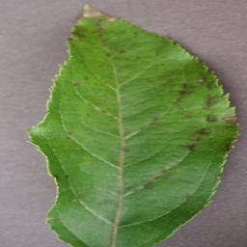



Slide 4
Different plant disease
Conv2d + Relu
Conv2d + Relu
Conv2d + Relu
Conv2d + Relu
Conv2d + Relu
Max-Pooling
Resizing and Rescaling
Conv2d + Relu
Max-Pooling
Conv2d + Relu
Conv2d + Relu
Max-Pooling
Conv2d + Relu
Conv2d + Relu
Dense
Dense
Dropout
Flatten
Output
Convolutional and Max Pooling Layer

